Slide 1
Transfer Learning in Image Classification
Course: INFO 536 – Applied Machine Learning
Group Members:
Muhammad Qureshi B00980214
S V Arun Varma Vanaparthi B00977899
Nitish Devineni B00974880
Loksharan Saravanan B00979751

Slide 2
Introduction
The use of image augmentation and transfer learning techniques to picture classification tasks is
the main emphasis of this study. The goal is to illustrate how these techniques can greatly
improve model performance and show their effectiveness when data is limited.
Project Objective:
The project aims to categorize photographs into several categories using a pre-trained model that
has been updated and fine-tuned for the specific task. In addition, the initiative intends to
increase the datasets to overcome the limits of limited datasets.
Scope and Relevance:
This method is especially useful in domains where gathering huge datasets is difficult or
impractical. The research demonstrates how high picture classification accuracy may be attained
with less data by utilizing transfer learning and image augmentation.

Slide 3
Methodology
Base Model:
A neural network built from scratch using TensorFlow and Keras.
Multiple convolutional layers, max pooling layers, dropout for regularization, dense layers.
Training on augmented dataset to address limited data issues.
Transfer Learning Model:
Utilizing a pre-trained model (e.g., FModel) adapted for the MNIST digit classification task.
Freezing layers up to Flatten, adding new dense layers for specific digit recognition.
Leveraging pre-existing knowledge for improved performance on the MNIST dataset.

Slide 4
Training & Validation Process
Data Preparation:
The dataset, which was initially small, is expanded to generate a more robust collection for training. Preprocessing, resizing, and category format encoding of the labels are applied to the images.
Training Strategy:
To achieve generalization and prevent overfitting, the model is trained on the augmented dataset with a split between training and validation data.

Slide 5
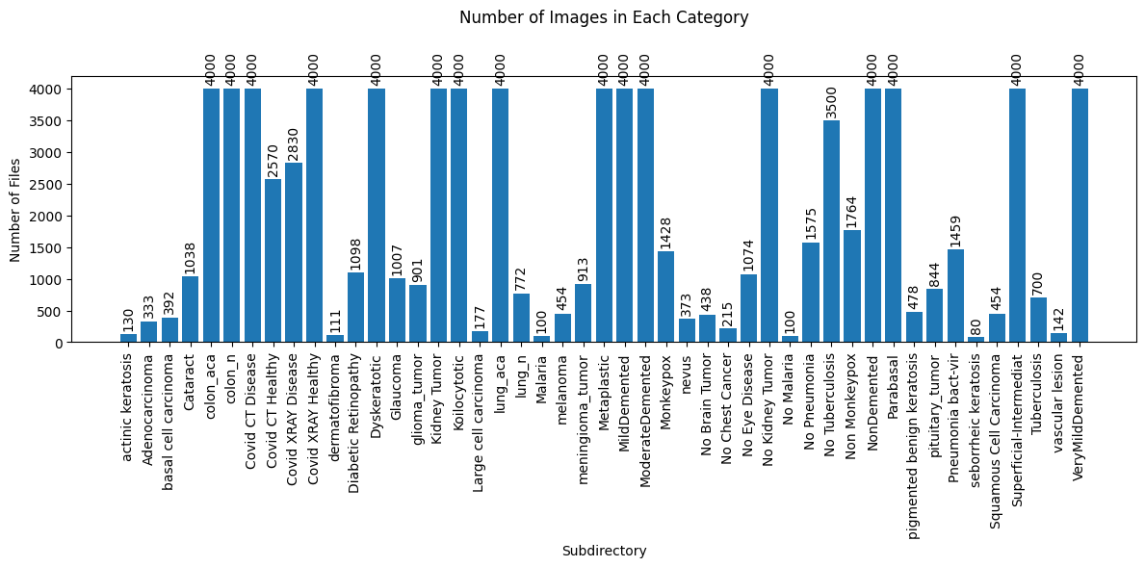
Number of images generated:

Slide 6
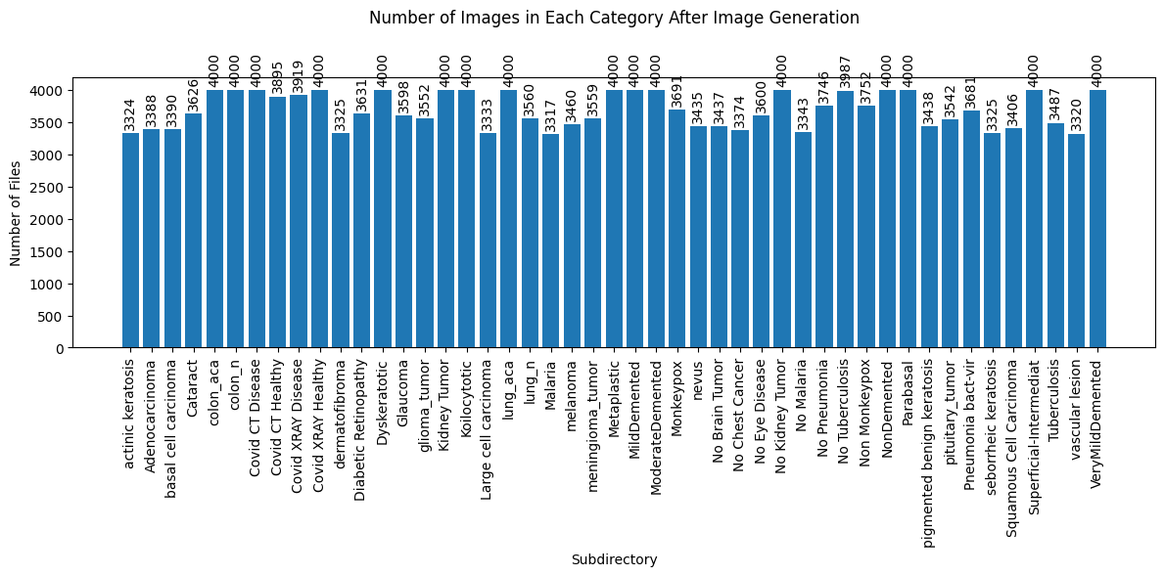
Number of images generated between 3000-4000:

Slide 7
Evaluation & Results
Result Analysis:
The convergence behavior and learning efficiency of the model are revealed by examining the learning curves (accuracy and loss) over training epochs.
Optimizer:
The Adam optimizer is employed, which is a stochastic gradient descent
extension that is well-known for its effectiveness in dealing with sparse gradients and
adaptive learning rates.
Training Procedure:
Using both training and validation datasets, the model is trained for 25epochs with a batch size of 16.

Slide 8
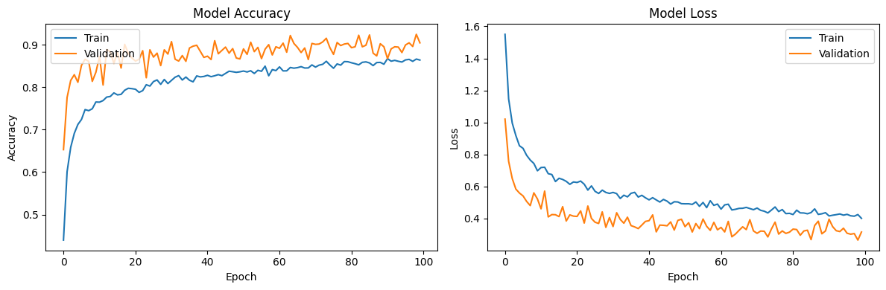
Results

Slide 9
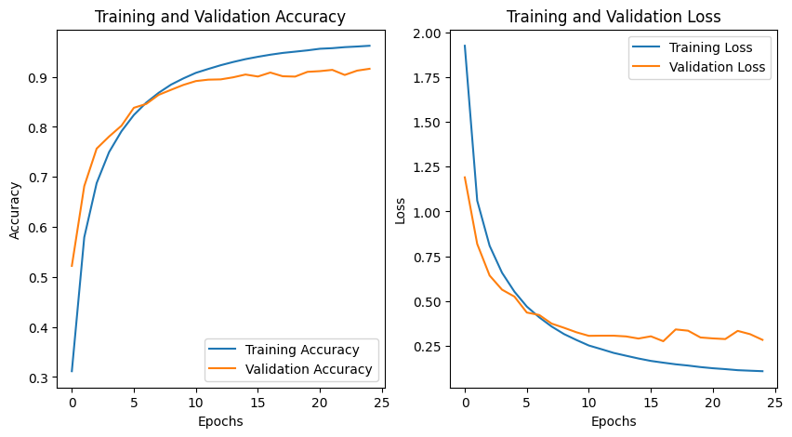

Slide 10
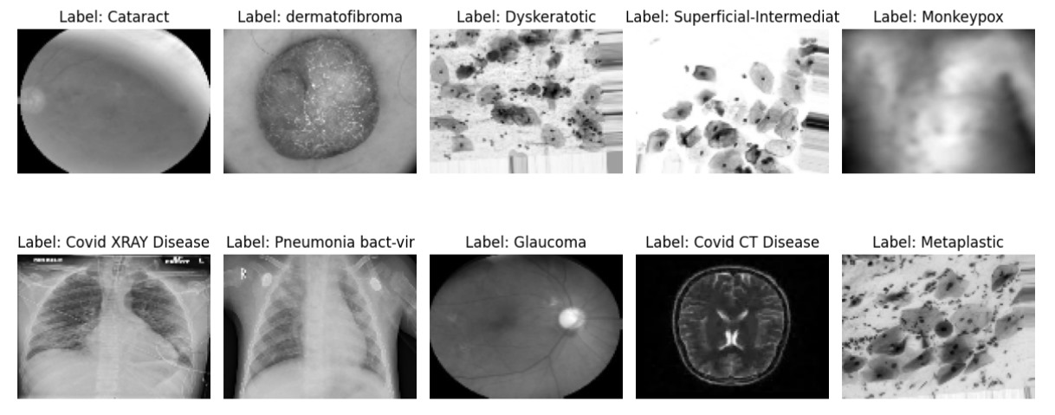
Images generated

Slide 11
Summary
The Transfer Learning project focuses on using transfer learning techniques in image classification, which might be useful in situations when there is not much data.
TensorFlow and Keras are used to create the base model.
The project used a pre-trained model (FModel) in parallel and modifies it for the MNIST digit classification task.
Using a scaled and normalized dataset, this model is trained to demonstrate the effectiveness of transfer learning in adjusting to new tasks.

Slide 12
Conclusion
The study effectively illustrates the power of transfer learning in conjunction with picture augmentation for image classification tasks. When a pre-trained model is used, training time and computational resources are greatly decreased without sacrificing accuracy.
Several pre-trained model experiments, an examination of alternative picture augmentation methods, and the application of the methodology to diverse other kinds of data are some ideas for future research.
The project’s approach, methods, and conclusions are summarized in this article, which also highlights the potential benefits of picture augmentation and transfer learning for improving the performance of image classification models, particularly in settings with little data.

